Slide 1
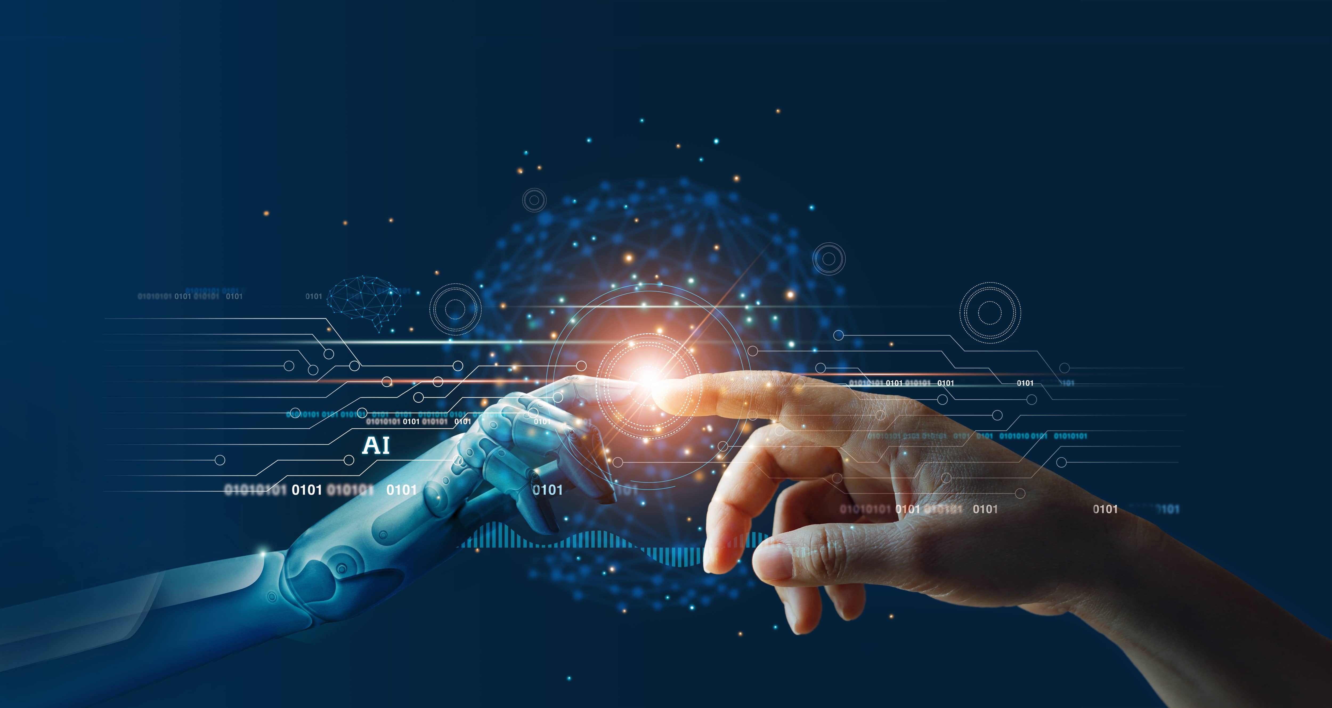
Artificial Intelligence
Name – Mansheen Singh
Class – ITB
CRN - 2221125

Slide 2

What is Artificial Intelligence?
AI is a rapidly growing field that focuses on creating intelligent machines.
It involves simulating human intelligence to enable machines to learn, reason, and make decisions.
AI has applications in self-driving cars, virtual assistants, medical diagnosis, natural language processing, and financial fraud detection.
Self-driving cars use AI to navigate and improve road safety.
AI-powered virtual assistants respond to voice commands and make our lives more convenient.
Artificial intelligence has the potential to revolutionize various industries. This card provides an overview of AI, its capabilities, and its potential impact on our lives and work.

Slide 3
History of Artificial Intelligence
The idea of intelligent machines dates back to ancient Greek myths about robots and automata.
In the 20th century, pioneers like Alan Turing, John McCarthy, and Marvin Minsky laid the foundation for modern AI with their work on logic and reasoning.
During the 1950s and 1960s, the field of AI saw rapid progress with the development of machine learning algorithms and the creation of expert systems.
In the 1980s and 1990s, AI research shifted towards neural networks and the creation of intelligent agents for decision-making.
Today, AI has advanced to include deep learning, natural language processing, and computer vision, among other cutting-edge technologies.

Slide 4

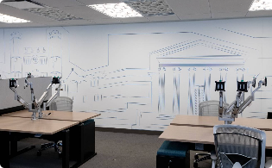

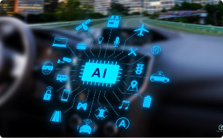
Companies Leading the AI Revolution
Google
IBM
Tesla
.
Amazon

Slide 5



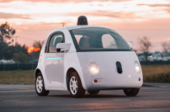
AI Contribution in Day to Day Life
Recommendation Systems
Healthcare
Transportation
Personal Assistants
AI-powered personal assistants like Siri, Alexa, and Google Assistant help us find information, manage our schedules, and control smart home devices with just our voice.
Online shopping and streaming services use AI-powered recommendation systems to suggest products, movies, and TV shows that match our interests and preferences.
AI is being used to improve healthcare outcomes by analyzing patient data, aiding in diagnoses, and developing personalized treatment plans.
Self-driving cars, trucks, and drones use AI to navigate roads and avoid obstacles, making transportation safer and more efficient.

Slide 6



Benefits of AI
Increased efficiency
2. Reduced errors
3.Cost-effective
AI can perform tasks quickly and more accurately than humans, leading to improved efficiency in operations
Unlike humans, AI machines don’t get tired or distracted. This leads to a reduction in costly errors in various industries.
AI powered systems can work round the clock, leading to significant cost-saving for companies.

Slide 7

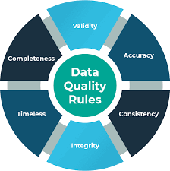

Challenges of AI implementation
1. Data quality 2. Costs 3. Ethics and responsibility
Quality data is the fuel that powers most AI systems. Poor data quality can seriously undermine AI’s effectiveness.
Developing an AI system requires a lot of money, time, and expertise, which isn’t always available.
As AI becomes more advanced, ethical considerations such as data privacy, security, and transparency will become more pressing.

Slide 8
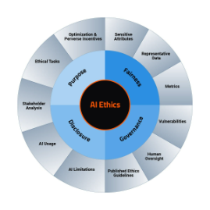


Ethical Considerations of AI
1.
Privacy
2.
Fairness
3.
Accountability
AI can collect and use large amounts of personal data. It's important to protect user privacy and ensure that data is collected and used ethically.
AI systems can perpetuate existing biases and inequalities. It's important to design AI systems that are fair and unbiased.
AI systems can make mistakes or produce unintended consequences. It's important to ensure that AI systems are transparent and accountable.

Slide 9



Future Aspects of AI
Brain-Computer Interfaces Autonomous Drones Smart Cities
Research is currently underway to interface brains with machines directly. This technology have significant implications for healthcare, communication and entertainment.
Drones can be used for a wide range of tasks, from surveillance and delivery to agriculture and healthcare.
AI will play a critical role in the development of smart cities, where data and technology are used to improve efficiency and quality life for citizens

Slide 10
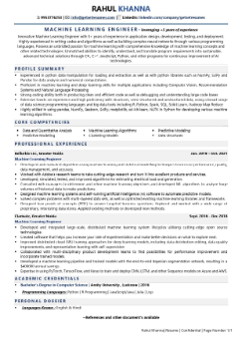

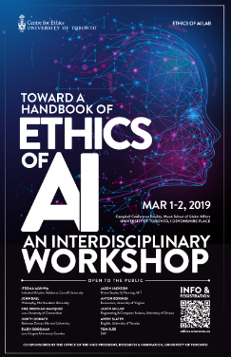
Job Opportunities in AI
1
Machine Learning Engineer
2
Data Scientist
3
AI Ethics Specialist
Data scientists analyze and interpret complex data to extract valuable insights and inform decision-making. They use statistical and machine learning techniques to identify patterns and trends in data.
Machine learning engineers use algorithms and statistical models to build AI systems that can learn from data and improve over time. They typically have a strong background in computer science, mathematics, and statistics.
AI ethics specialists ensure that AI systems are designed and used in an ethical and responsible manner. They work with teams to develop ethical frameworks for AI and ensure that AI systems align with legal and ethical standards.

Slide 11
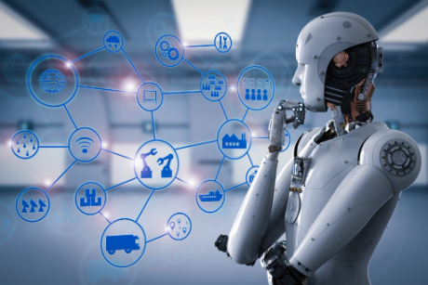
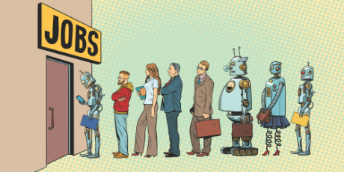
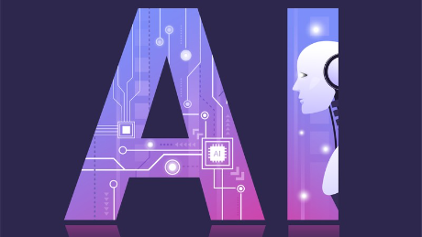

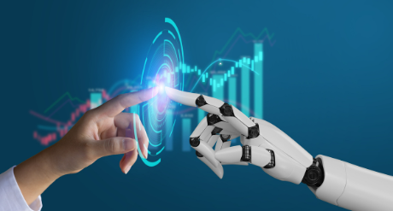

Pros and Cons of AI
PROS
Cons
Data analysis
Potential job displacement
Efficient decision-making processes
Data privacy and security concerns
24/7 availability
Dependence on technology and loss of human touch

Slide 12
Conclusion
.
AI is rapidly evolving technology that has the potential to transform various industries
and aspects of our lives. While it presents numerous benefits, it also poses significant
challenges, particularly in areas such as ethics, regulation, and transparency . Its essential
to approach AI pragmatically and with caution, while also maximizing its potential to bring
about positive change
.

Slide 13

Thank You!

